Slide 1
Final Presentation
Muhammad Hazim Bin Sulaiman
Intern for SWTC(Engineering Team)

Slide 2
Purpose of internship
Practice what I’ve learnt
Manufacturing processes
CAD(engineering modelling)
Fluid mechanics
Strength of materials
Learn new things
Assemblies of mechanical parts
Tolerance analysis
A bit of structural analysis through design verification
Design for manufacturing
Notes:
Apply concepts to real life engineering
Expose ourselves to other parts of engineering that can’t be taught in school

Slide 3
Engineering Team (MRL)
Scope of concept: Develop a new MPFM that uses the V-channel and ultrasonic technology
As a mechanical engineering intern -> support in mechanical aspects
Creation of parts using Creo
Help out in mechanical assemblies
Notes:
SWTC is a under the testing and process product group in which we manufacture MPFM
In swtc, I am attached to the engineering team
General description of the engineering team and where do I fit in this team
Devt phase of concept 5 vchannel
Ultrasonic
This also summarises the job description/scope that was set for me by the company at the start of the internship

Slide 4
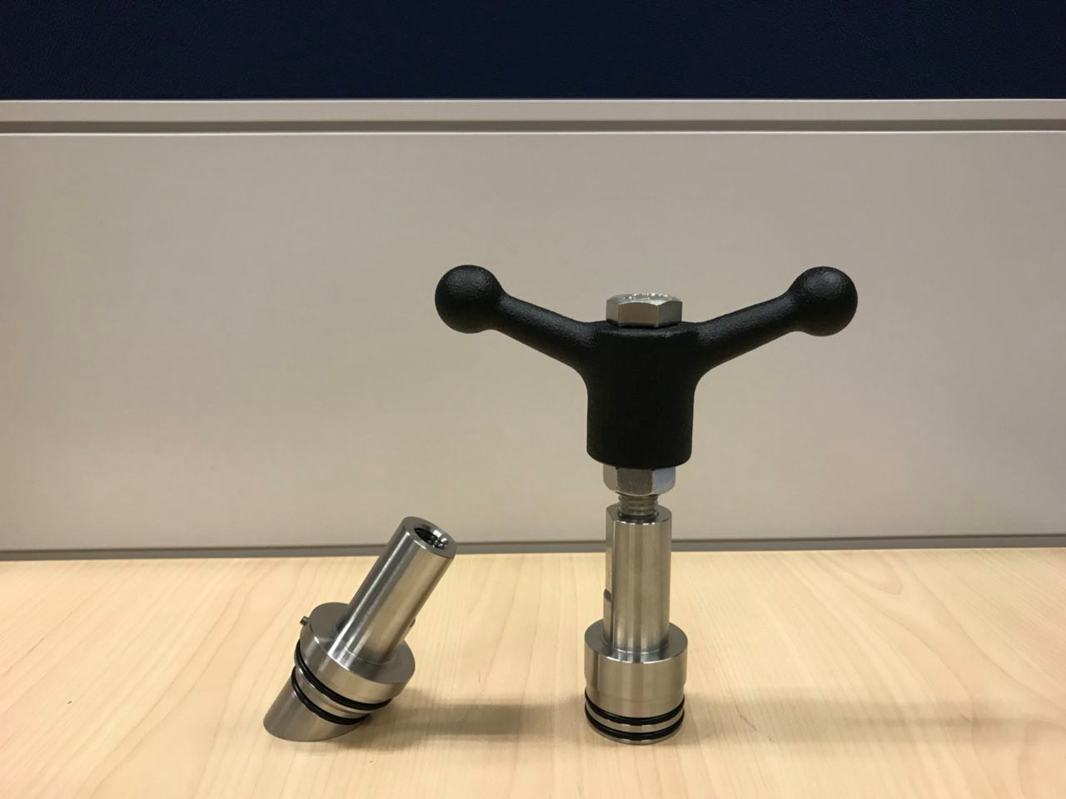
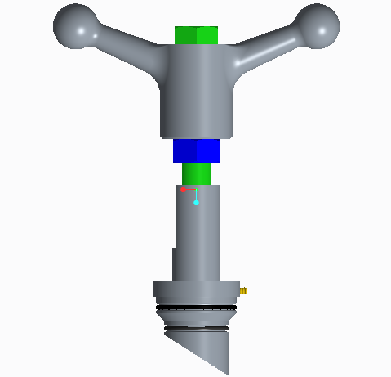
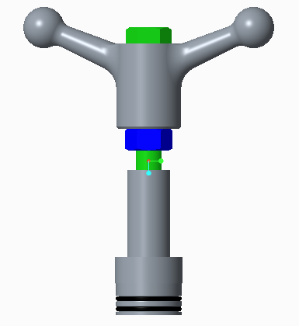
Plug project
Design of ToF and Doppler plugs for use in pressure tests for V-channel
Good initial project to get used to Creo
Selection of O-rings through parker o-ring manual and o-ring dimension calculators
Assembly
Notes:
How was it designed
Obtained the v-channel model in creo
Measured necessary dimensions
Made a replica of the ToF and Doppler holes
Do not mention the issues

Slide 5
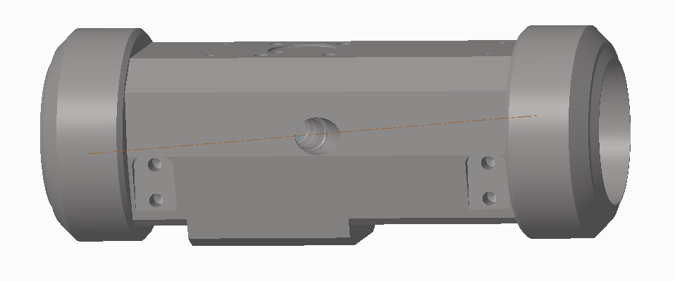
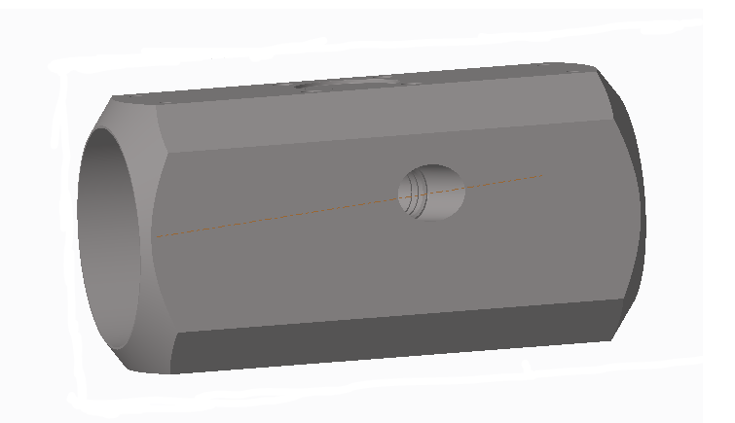
6-inch V-channel project
6-inch version of the V-channel
Purpose
Project requirement
Can the cost be reduced further?
Manufacturability?
Notes:
How the eventual product can be reduced further by cost assessment.
This is a project requirement and this was done on all emerging new products.
How it was transformed from a 14 inch.
Goes through many iterations to reach the final form.
Short description of the purpose. Just a project requirement

Slide 6
Acrylic V-channel project
Liaise with Cambridge SCR (Peter Johnson) to create a prototype that they will be manufacturing
To be used for the research on V-channel
Transparent material for recording of flow and analysis
Obtain the prototype from Fuad and continued from where he left off
Modify and create drawings out of the parts and assembly
Much more complicated than previous projects:
Complex design and assembly
Use of helicoil and compression fitting
Casting is used
Notes:
Think of the part that I come into the picture
Detail design, design for asm considerations and drawing
State only what I do
Helicoil and Dk-Lok fittings are not parts that we are used to. A bit of research has to be done to know the purpose and requirements of each parts.
Casting is used, which means that the references are in weird angles

Slide 7
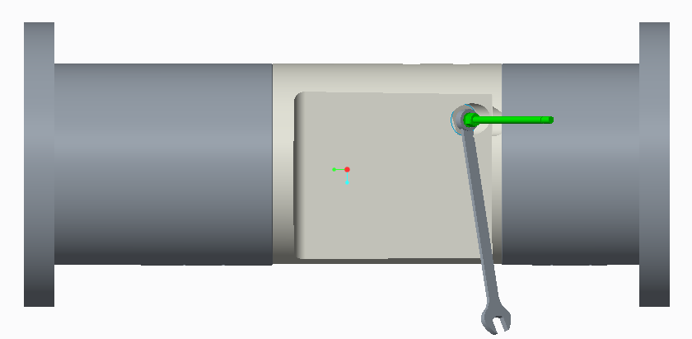
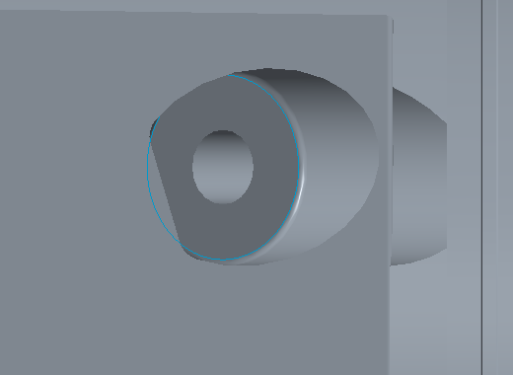
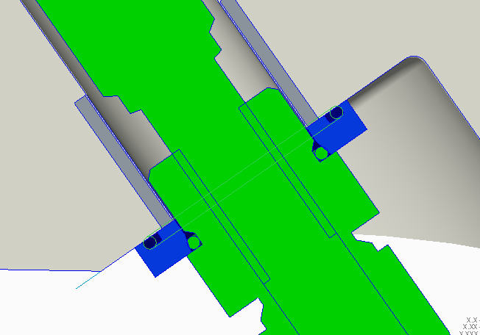
Notes:
Point out eccentric feature
Aesthetics over useablility
Design is situational, whether it is for research or for
Design for assembly – use creo to verify the assembly in real life

Slide 8
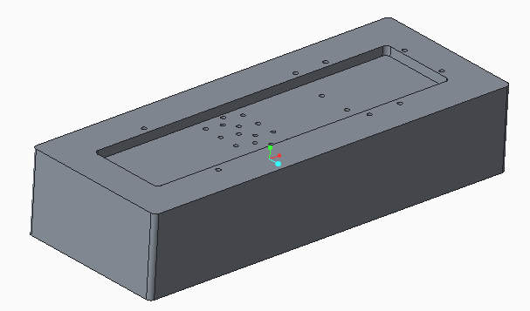
Fixture project
Simple yet complicated model(because of tolerance analysis)
Fixture to mount and solder spring loaded connectors to a rigid PCB
GD&T application
Skill rather than simple application
Notes:
PCB in general have very tiny features, so using references to normal datums will not be sufficient in getting the accuracy that is needed.
Therefore GD&T is used to refer the features to other features
Not easy to machine with such accuracies, so we try our best to model it with use of GD&T to specify as much as possible the accuracy that is intended for the features here
One gd&t method was to reference each hole to each other along with the reference to common datums
Skill rather than application – pick out dimensions that could affect the position of the feature that you intend to make

Slide 9
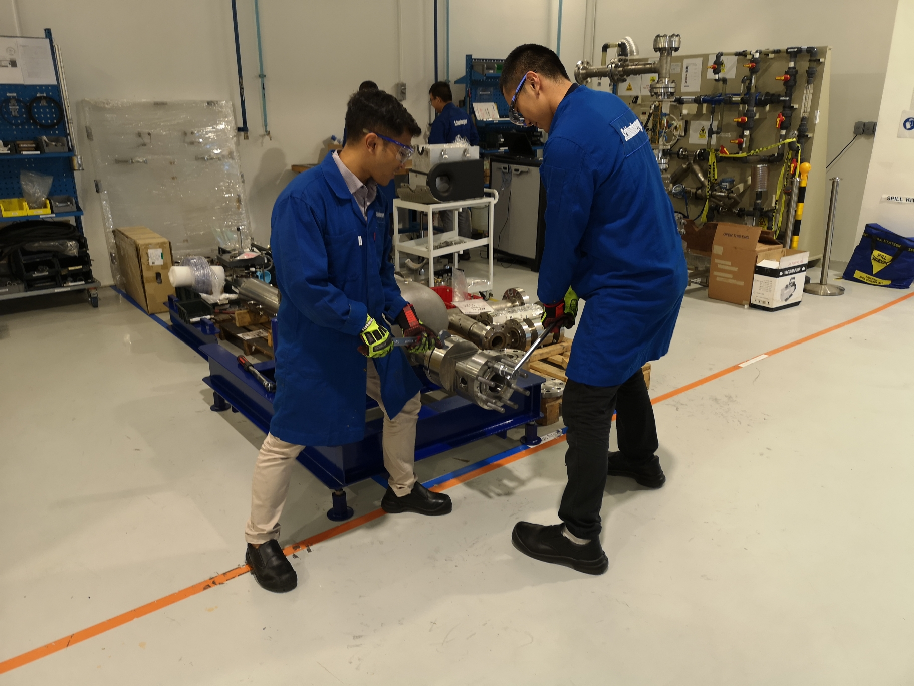
Assembly skills
Did assembly on
Retaining rings
O-rings
Flanges & Spools
Compression Fittings
Picked up other useful skills as a result
Housekeeping (6S)
SIPP(Schlumberger Injury Protection Program)
Manual lifting skills
Body positioning
Notes:
Skills picked up in SIPP and practiced. Comment on the picture where we used a good posture
6S – steps to maintain cleanliness within your workspace
Having a clean place would naturally mean hazard is minimised
Sipp – training program to learn about movements and techniques to reduce short term and long term injury

Slide 10
Conclusion
Positives
Learnt a lot of useful knowledge and deeper understanding of concepts
Good working ethics and habit picked up from the people here(eg. Modelling from a block)
Be more predictive over failures -> More critical over my work
Negatives/Things to work on
Better understanding on tol analysis. Reading materials are readily available
Use of FEA
Still a lot to learn in Creo
Notes:
Confirm the manufacturability of a part
In design use, Creo still has many features. (sheet metal bending, toiroidal bending, rigid body assembly)
Refer back to purposes.

Slide 11
Purpose of internship
Practice what I’ve learnt
Manufacturing processes
CAD(engineering modelling)
Fluid mechanics
Strength of materials
Learn new things
Assemblies of mechanical parts
Tolerance analysis
A bit of structural analysis through design verification
Design for manufacturing
Notes:
Fulfilled my personal objectives

Slide 12
End of Slide

